Slide 1

Project Title - Seasonal Agriculture Performance Analysis
[Student Name: Kusam Varshitha
College Name- Sasi Institute of Technology & Engineering]
AICTE STU ID : STU67ea65118282d1743414545

Slide 2

PROBLEM STATEMENT
Agricultural activities are influenced by seasonal variations in environmental conditions, farming practices, resource availability and market conditions. As a result, agricultural performance may differ from one season to another. However, raw agricultural data does not clearly explain how agricultural performance changes across seasons or what patterns can be observed in different seasonal conditions. The problem is to analyze the given agricultural dataset and investigate seasonal differences in agricultural performance by identifying meaningful patterns, trends, relationships and variations within the available data.

Slide 3
Project Description
Agricultural performance can vary significantly from one season to another due to changes in environmental conditions, farming practices, resource availability and other factors. These variations can affect crop yield, disease and pest risk, resource utilization and overall agricultural outcomes.The available agricultural dataset contains information from different seasons and farming conditions, but the underlying patterns and relationships are not immediately clear. Therefore, there is a need to analyze the data
systematically to understand seasonal variations, compare agricultural performance, identify relationships between important variables and discover significant patterns.This project focuses on using data cleaning, statistical analysis and visualization techniques to examine the dataset and generate meaningful, evidence-based insights that can support better seasonalagricultural planning and decision-making.

Slide 4

WHO ARE THE END USERS?
Users:-
Farmers
Agricultural Officers
Agricultural Planners
Researchers and Data Analysts
Government and Policy Makers
Agricultural Organizations

Slide 5

Technology Used
Python
Google Colab
Pandas
NumPy
Matplotlib
Seaborn
Data Visualization
Statistical Analysis

Slide 6
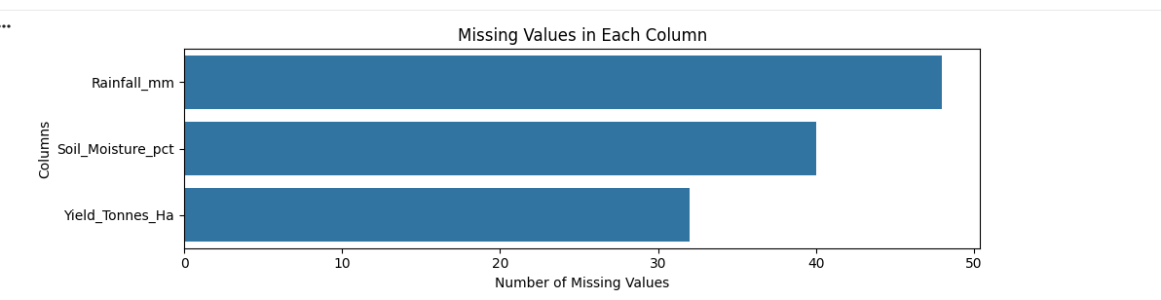
RESULTS

Slide 7
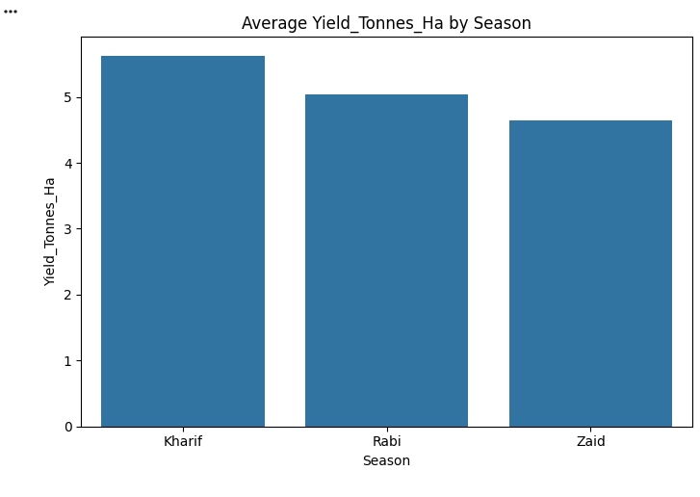
RESULTS

Slide 8
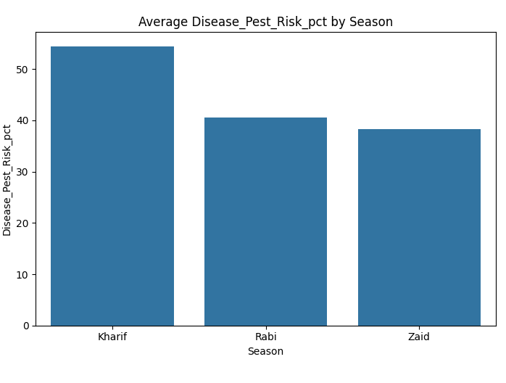
RESULTS

Slide 9
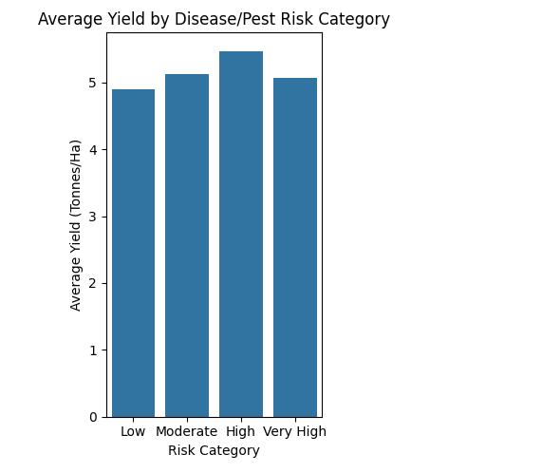
RESULTS

Slide 10
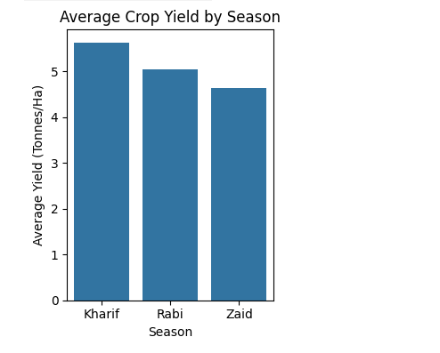
RESULTS

Slide 11
Future scope
Real-Time Agricultural Monitoring
Predictive Crop Yield Analysis
Weather-Based Crop Planning
Disease and Pest Prediction
Advanced Machine Learning Models
Regional Agricultural Comparison
Resource Optimization
Agricultural Decision Support Systems

Slide 12
GitHub Link:-
https://github.com/varshithakusam/Seasonal-Agriculture-Performance-Analysis-.git

Slide 13

VOIS Course completion certificate - Course name- Data Visualization

Slide 14
Thank you
.
.

